Slide 1

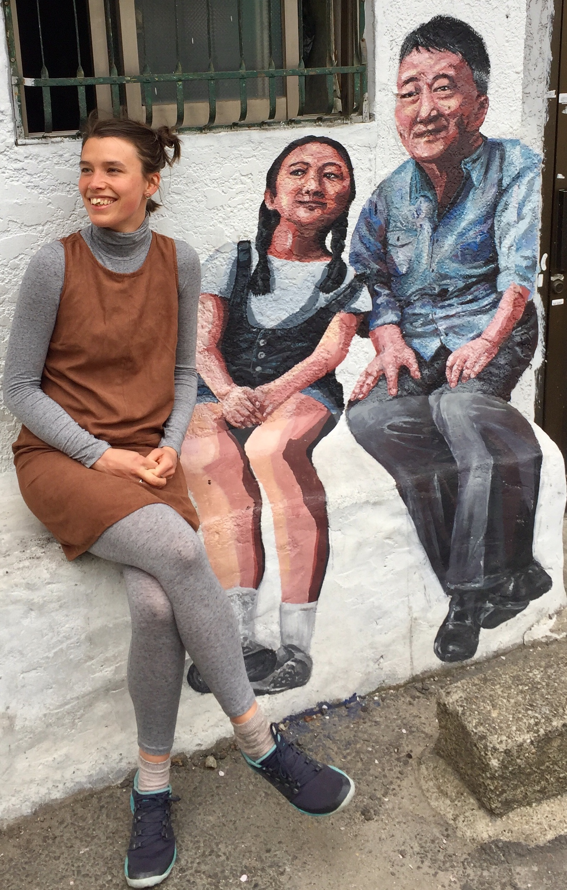


Hi, I’m Lucy!

Slide 2
Hi, I’m Lucy! And I’m a…..
Physicist, computational materials scientist, PhD student, teacher
Woman, daughter, sister, wife, friend
Cyclist, mountaineer, movie-watcher, food-cooker…
Notes:
So this will be a bit of an unusual talk for me – because I’m going to talk about my science and my background – how I got here. And it’s really nice to have that opportunity. You know it’s so easy to keep going, once you’ve done one thing, you move onto the next. So to be able to reflect and share with you is a good thing for me. And

Slide 3
Hi, I’m Lucy! And I’m a…..
PhD student
Materials scientist
Maths teacher (Arden Primary school)
Uni student (Msci Theoretical Physics)
teacher
programmer
School student (Seaton Burn Community College)
physicist
0
10
20
31
Girl / woman
Daughter
Sister
Friend
Wife
Notes:
So this will be a bit of an unusual talk for me – because I’m going to talk about my science and my background – how I got here. And it’s really nice to have that opportunity. You know it’s so easy to keep going, once you’ve done one thing, you move onto the next. So to be able to reflect and share with you is a good thing for me. And

Slide 4
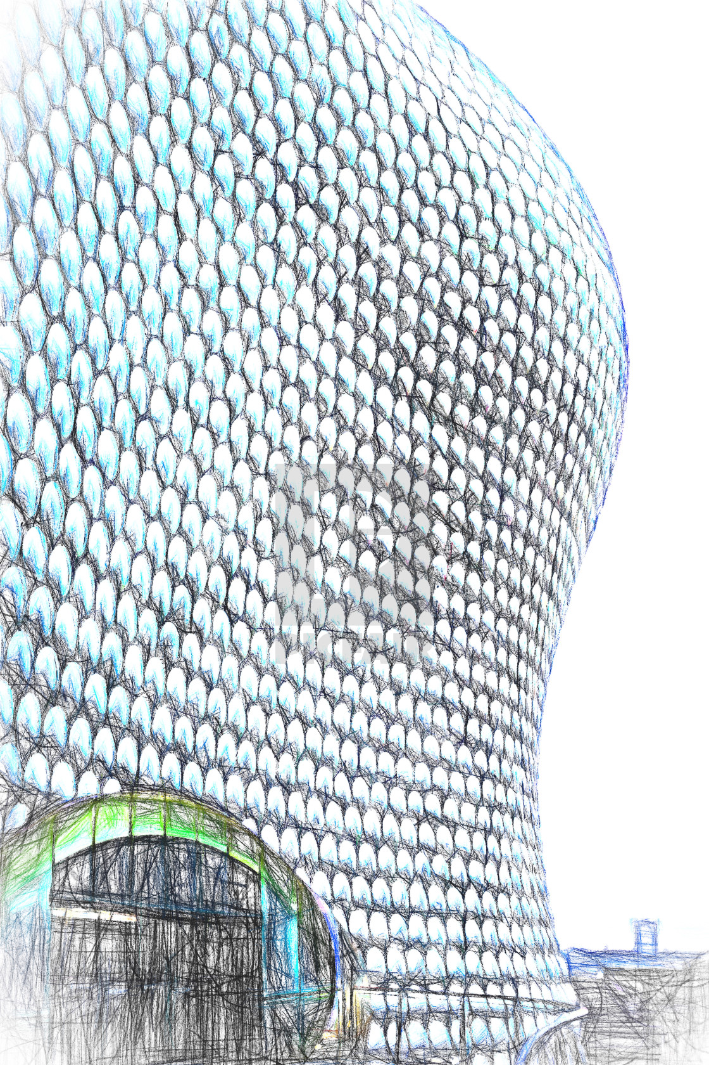

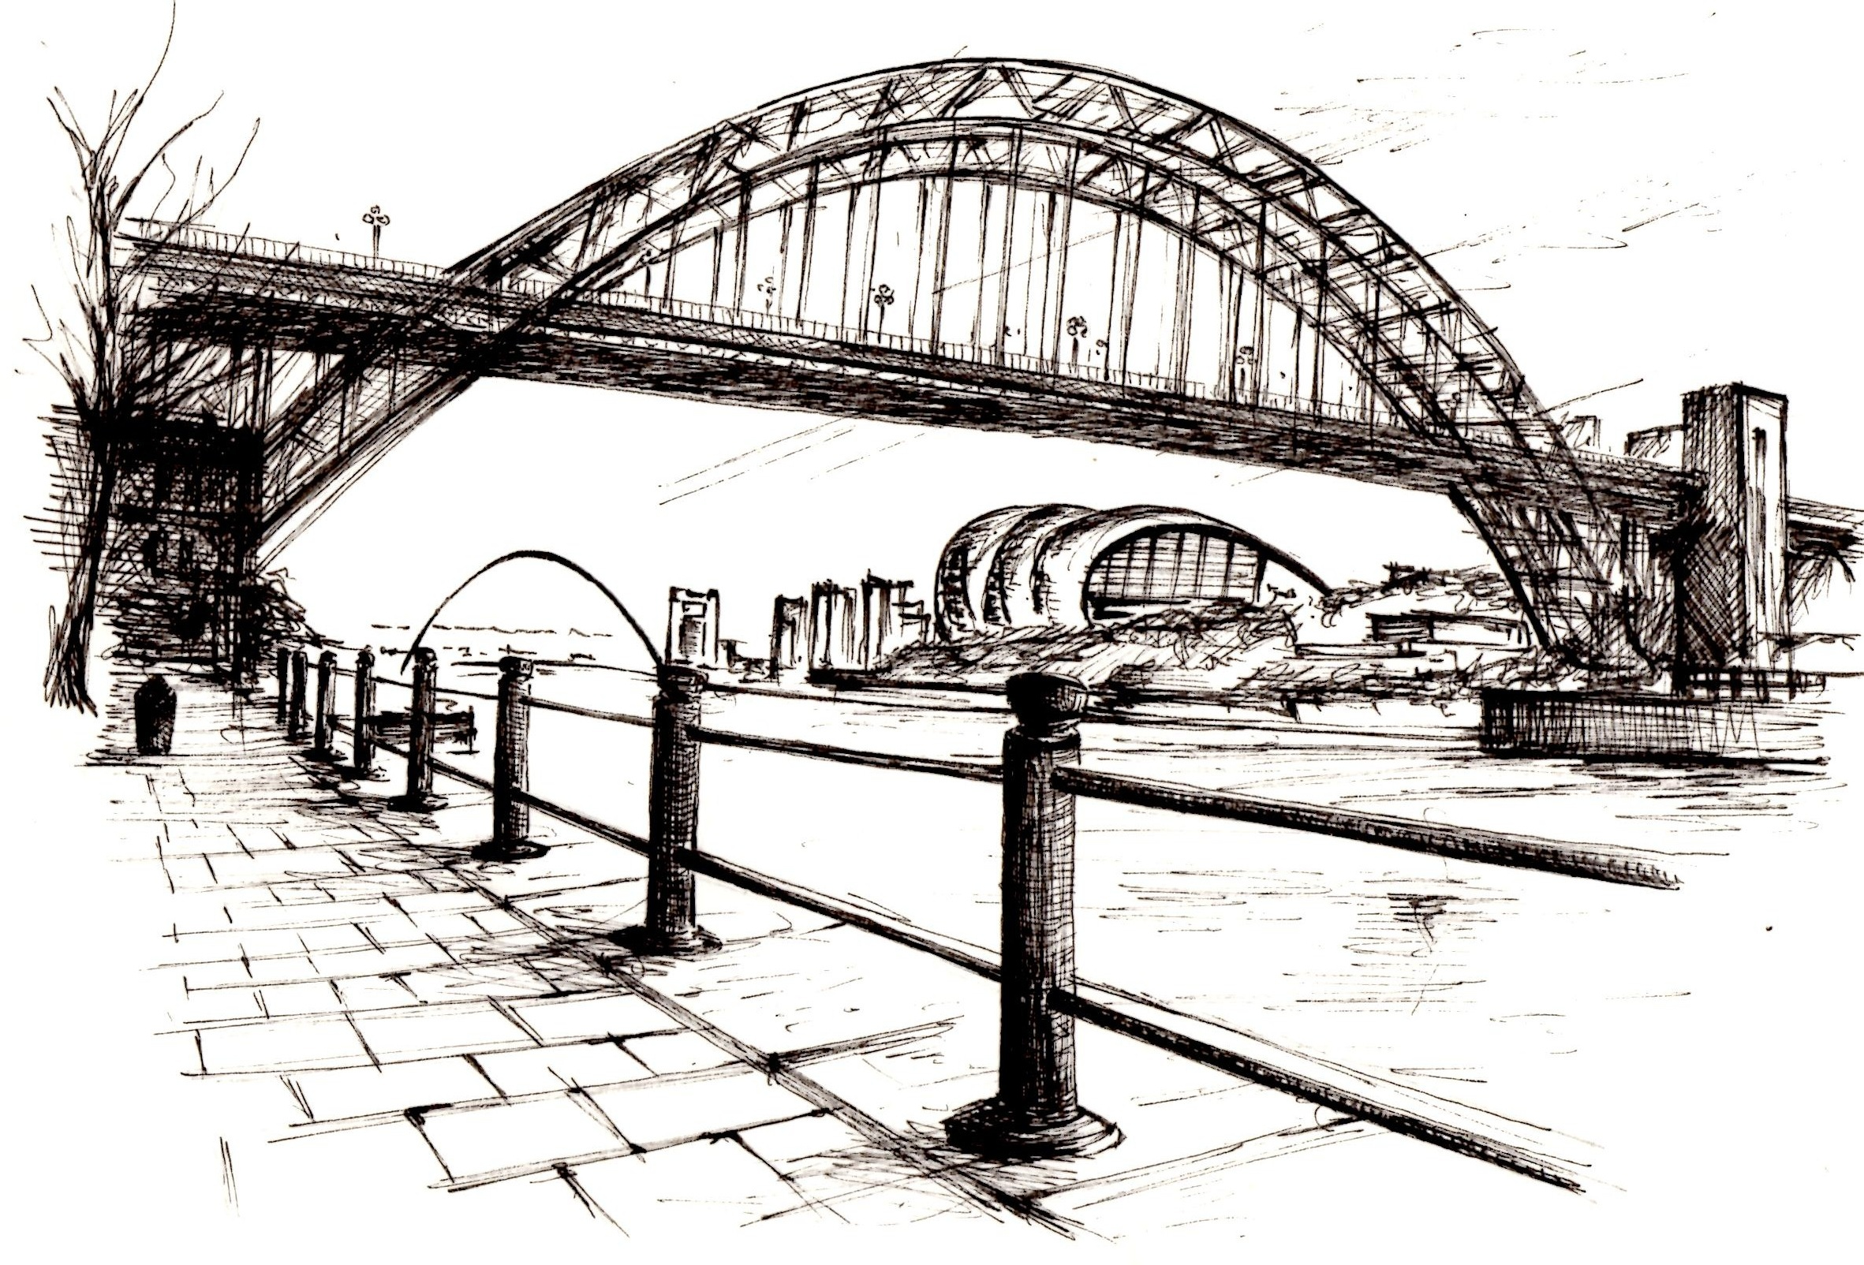

About Me
Newcastle
(19 years)
Birmingham: uni and teaching (12 years)
London: PhD work
(3 years)
Notes:
So this will be a bit of an unusual talk for me – because I’m going to talk about my science and my background – how I got here. And it’s really nice to have that opportunity. You know it’s so easy to keep going, once you’ve done one thing, you move onto the next. So to be able to reflect and share with you is a good thing for me. And

Slide 5
A-levels
Maths, Further Maths, Physics, Philosophy
Undergraduate degree
MSci Theoretical Physics / University of Birmingham
Teaching qualification
Her Majesty’s Prison Birmingham / Birmingham City University
Teaching job
Arden Primary School
PhD student
Computational Materials Science / Imperial College London
Notes:
So this will be a bit of an unusual talk for me – because I’m going to talk about my science and my background – how I got here. And it’s really nice to have that opportunity. You know it’s so easy to keep going, once you’ve done one thing, you move onto the next. So to be able to reflect and share with you is a good thing for me. And

Slide 6
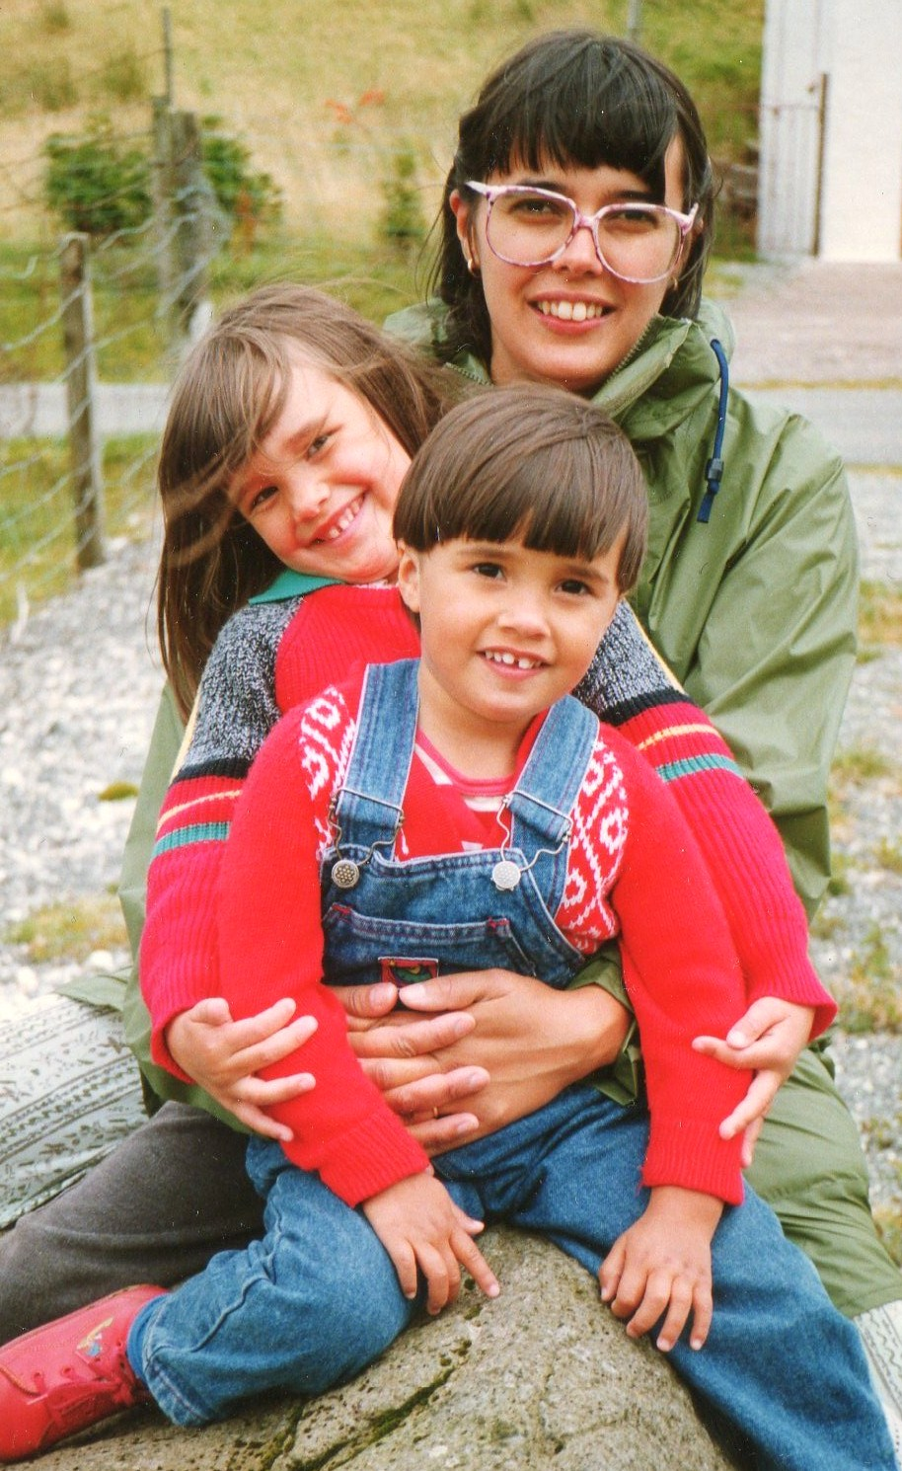
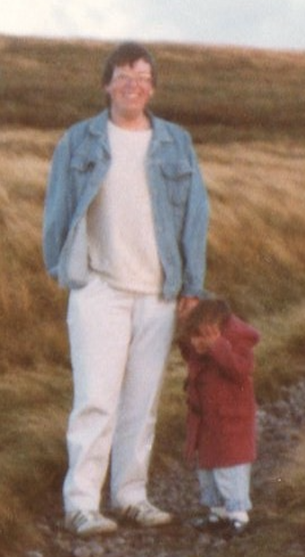
Mum
(welfare rights)
Me
Ruby
+ Dad
(nurse)
Notes:
Two things: no-one did science but did works that were very meaningful to them and I’ll come back to that

Slide 7



Why did I choose physics?
~Age 13
~Age 16
+ I always enjoyed studying
Notes:
So this will be a bit of an unusual talk for me – because I’m going to talk about my science and my background – how I got here. And it’s really nice to have that opportunity. You know it’s so easy to keep going, once you’ve done one thing, you move onto the next. So to be able to reflect and share with you is a good thing for me. And
And teachers said I was good!

Slide 8
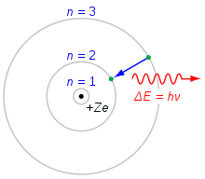
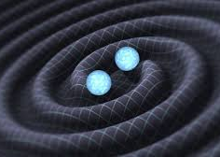
MSci Theoretical Physics
quantum mechanics
research project:
modelling electrons in a
quasi-2D metal
summer project:
analysing gravitational wave data
Notes:
So this will be a bit of an unusual talk for me – because I’m going to talk about my science and my background – how I got here. And it’s really nice to have that opportunity. You know it’s so easy to keep going, once you’ve done one thing, you move onto the next. So to be able to reflect and share with you is a good thing for me. And
Explain QM!
The really small and the really big: physics is great at accessing things beyond our everyday experience
No lab work

Slide 9
Why did I leave physics?
I couldn’t find a physics question that I cared about enough
I didn’t think I was good enough…
Notes:
So this will be a bit of an unusual talk for me – because I’m going to talk about my science and my background – how I got here. And it’s really nice to have that opportunity. You know it’s so easy to keep going, once you’ve done one thing, you move onto the next. So to be able to reflect and share with you is a good thing for me. And

Slide 10
Why did I leave physics?
Why did I return?
I couldn’t find a physics question that I cared about enough
I found out about energy materials
2. I didn’t think I was good enough…
I decided to ignore that voice in my head
I realised that very few people are “geniuses”
Notes:
So this will be a bit of an unusual talk for me – because I’m going to talk about my science and my background – how I got here. And it’s really nice to have that opportunity. You know it’s so easy to keep going, once you’ve done one thing, you move onto the next. So to be able to reflect and share with you is a good thing for me. And

Slide 11


Energy materials
= materials that generate and store energy
solar cells
batteries
To replace fossil fuels we need new cheap, long-lasting materials made from abundant elements
To design new materials we need physics!
Notes:
As fast as the human brain
This one needs its own power station
The carbon cost

Slide 12

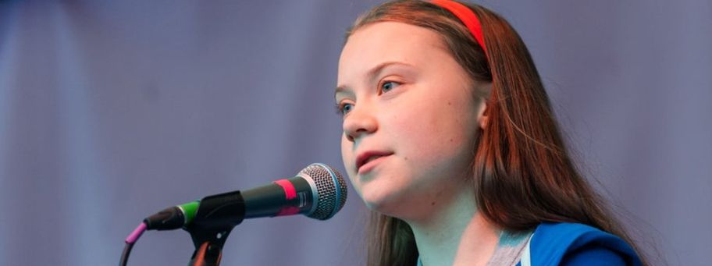
Notes:
As fast as the human brain
This one needs its own power station
The carbon cost
As a scientist this provides a lot of oppoortunities

Slide 13
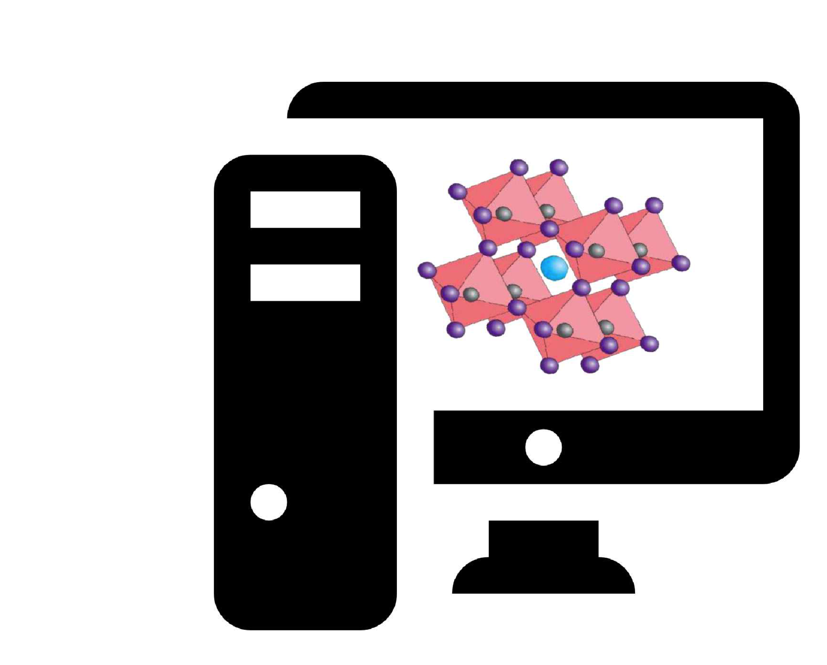
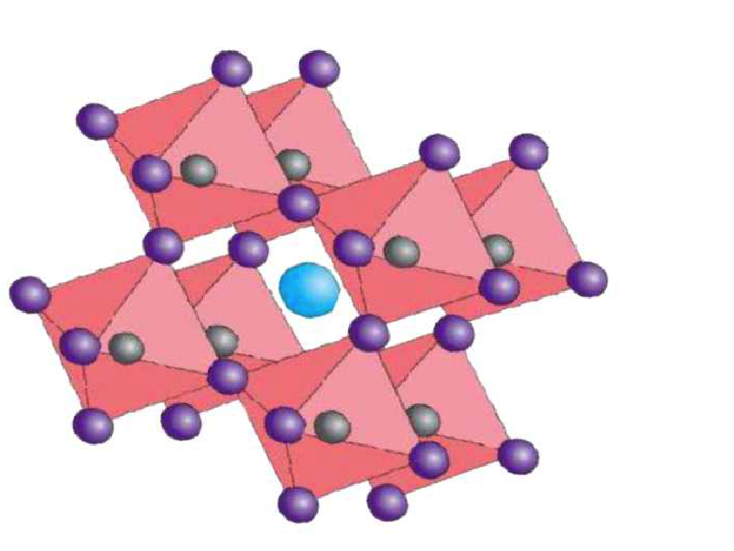
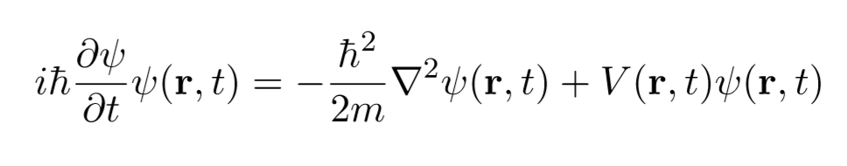

Computational modelling
stability
conductivity
hardness
elasticity
colour
+ more…
Input:
atomic structure
Solve QM
equations
Output:
material properties
Computational modelling can be used to develop new materials
Notes:
Put in a possible new material
The computer solves the equations
Simulating what is happening
And out comes the answer
Materials design – should be able to find new materials faster.
See if can find aron’s list

Slide 14
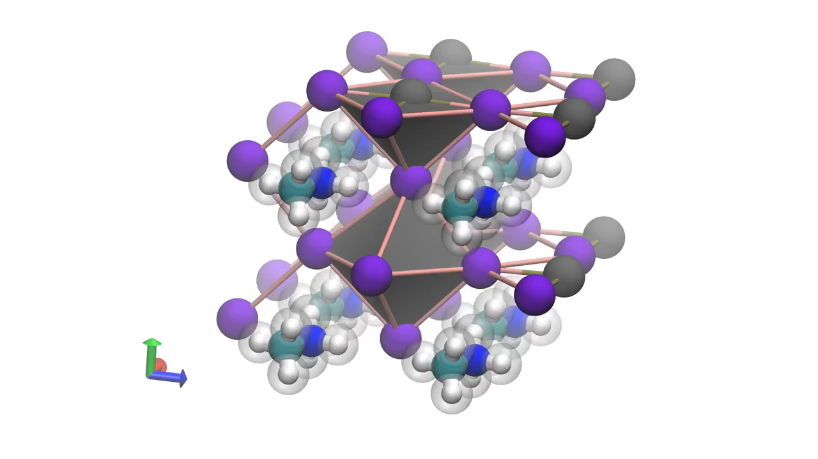
Example: vibrations in a solar cell material
(video courtesy of Jarvist Moore Frost)
Notes:
Put in a possible new material
The computer solves the equations
Simulating what is happening
And out comes the answer
Materials design – should be able to find new materials faster.

Slide 15
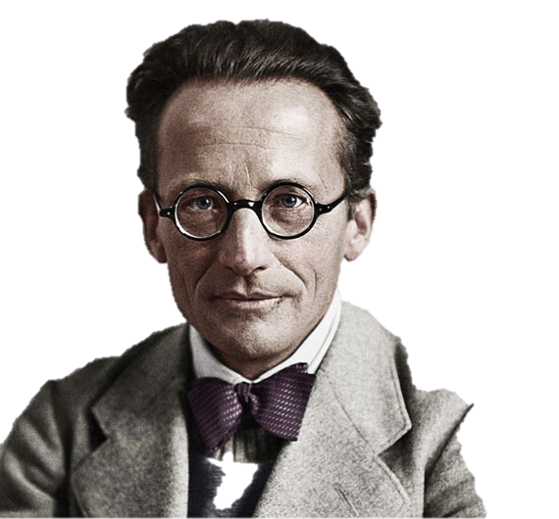
Ab-initio computational modelling
The Schrodinger Equation
1926
Notes:
Put in a possible new material
The computer solves the equations
Simulating what is happening
And out comes the answer
Materials design – should be able to find new materials faster.

Slide 16
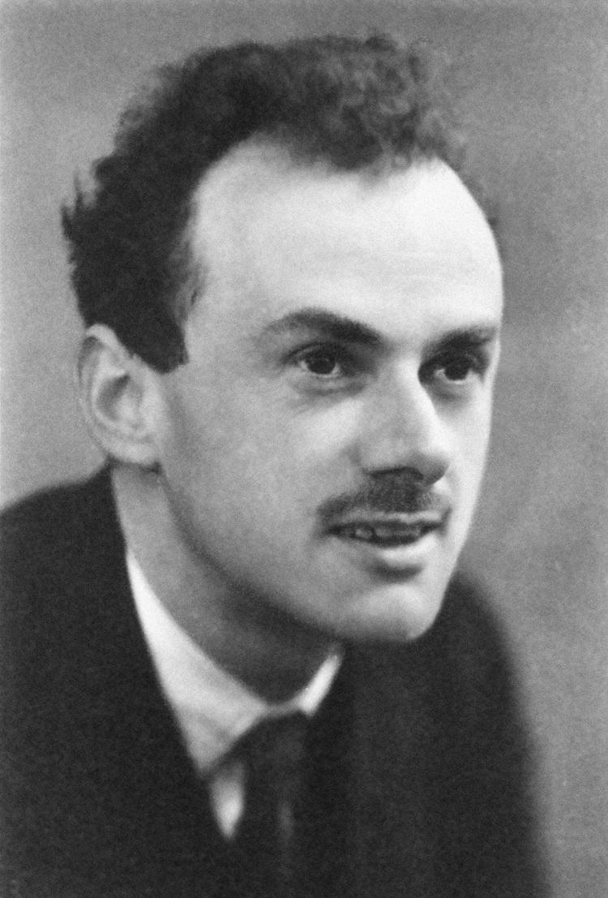
Ab-initio Computational modelling
“The underlying physical laws necessary for a large part of physics and the whole of chemistry are thus completely known, and the difficulty is only that the exact applications of these laws lead to equations much too complicated to be soluble.”
Paul Dirac
1929
Notes:
So to solve these complicated equation
We use two things: we have to make some approximations which means are answers aren’t exact – but they are close.
And the second thing we need is we need big computers - and I mean biiiig comi=puters

Slide 17
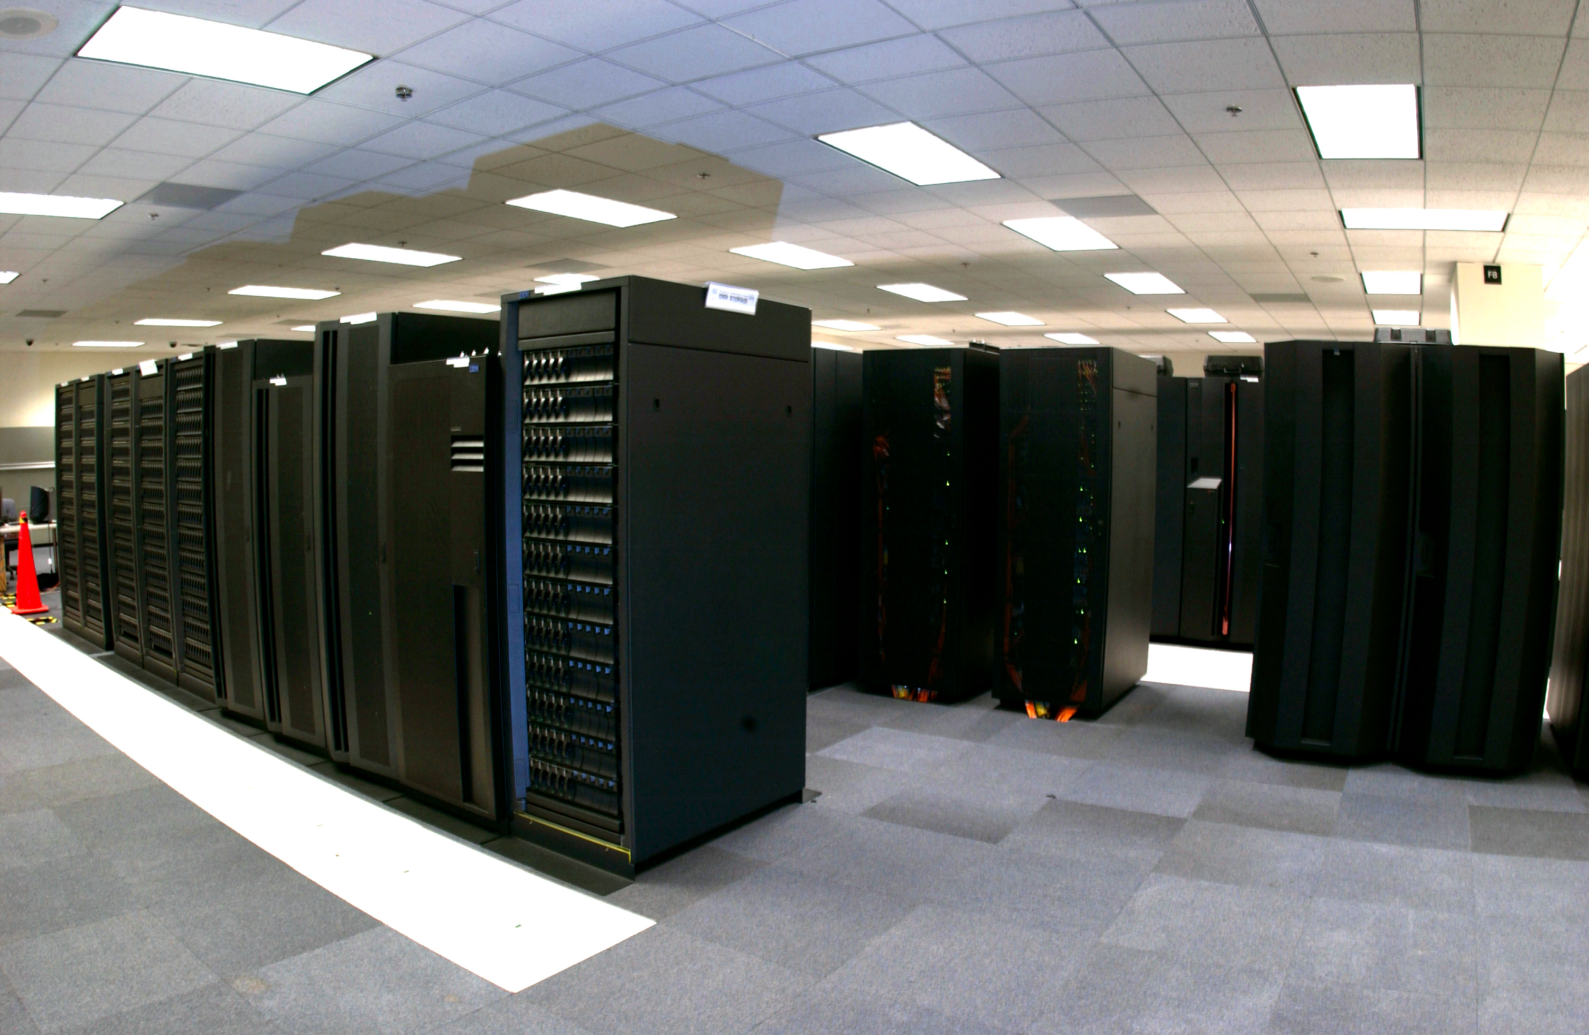
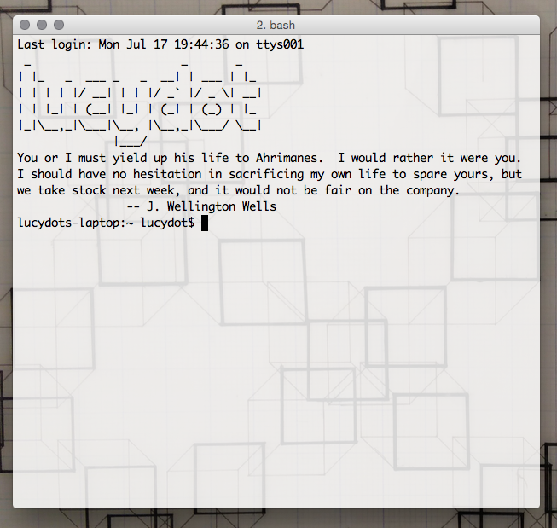
This is my lab…supercomputers!
Notes:
As fast as the human brain
This one needs its own power station
The carbon cost

Slide 18
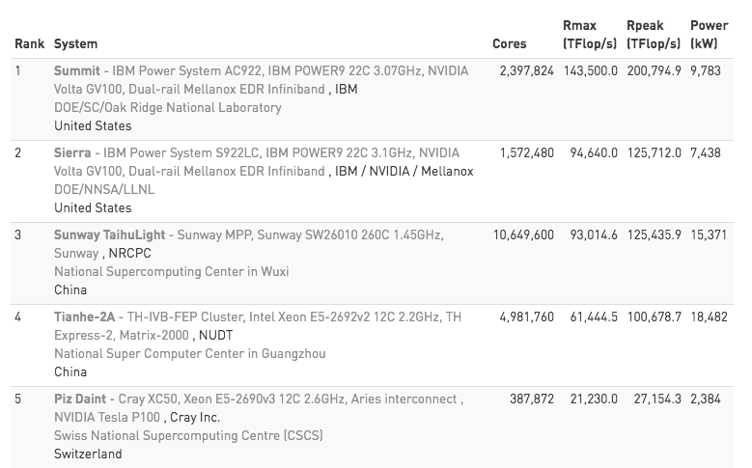
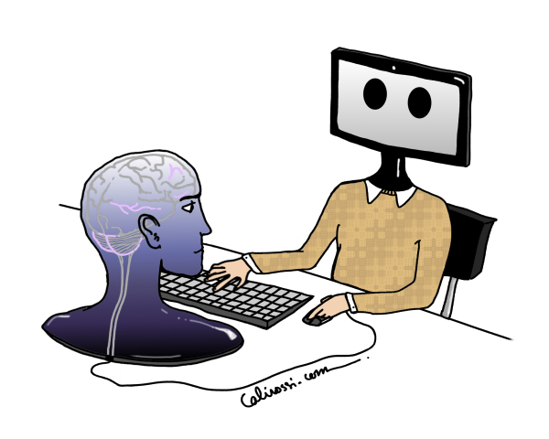
Fastest supercomputers in the world
> 1 exaflop/s
(1000000000000000000)
Notes:
As fast as the human brain
This one needs its own power station
The carbon cost
So I’ve talked about this amazing important question I am lucky enough to be working on, the super-cool supercomputers that I get to use So I found the question I wanted to study, but there was one other thing that I said earlier that was stopping me return to physics. Can anyone remember what it is?

Slide 19
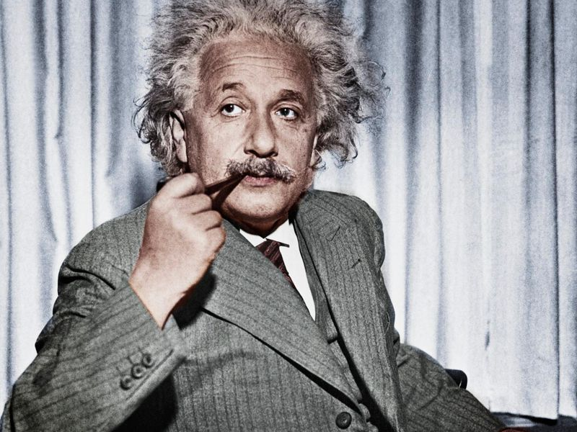
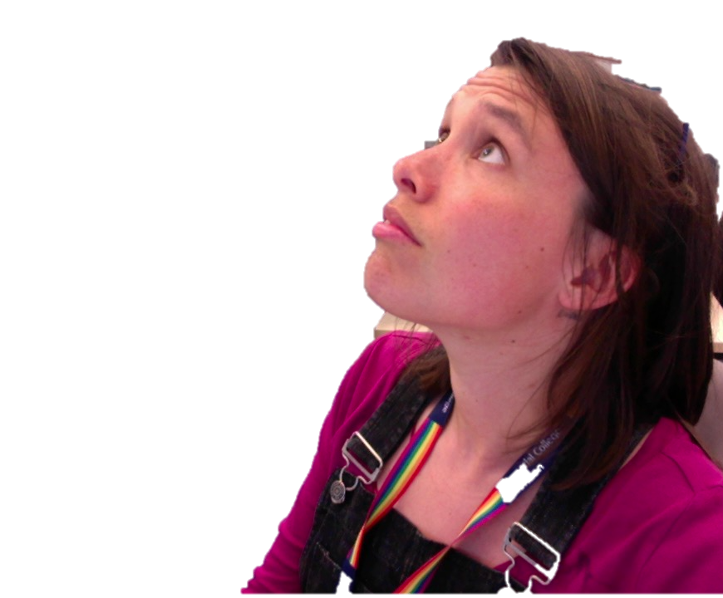
The problem with Einstein
I’m not a real physicist
Notes:
First off, Einstein did a lot of good physics. I’m not criticising einstein as a person or a physicist. But there is a bit of a cult that has built up around him - this idea that he is a genius, and that to do physics you too need to be a genius. I do think you need to have basic mathematical skills in place, I do think you need a good work ethic, I think you need to be interested in the topic – but I don’t think you need to be a genius. But we carry this idea around: that to do physics you need to be extra special, to do physics you need to be a gensus.
But this leads to problems. Because for those of us who do not feel like a genius, you think
It leads to imposter syndrome – who has heard of this?
This is the feeling that you are an imposter – that you are just pretending to be a physicists, a scientist – that some day someone will come along, tap you on the back and say “you know nothing!”, what are you doing here?! Get out of here. Get home!
Sociolgists have been studying imposter syndrome and they have found that Certain groups of people are more susceptible to imposter syndrome. Women are more susceptible, people from working class backgrounds are more susceptible – I fall into both of these categories and it’s certainly something I felt throughout my undergraduate degree and that I still do today, to be honest – but less so because I . Anyone can feel like an imposter, but I’m saying you’re more likely to feel this way

Slide 20
Don’t just think about academic labels (history, physics, business) – think about the type of question you want to answer
It is easy to doubt your ability as a physicist – have confidence in yourself and what you can achieve – GO FOR IT
Notes:
Physics can be used to answer some of the most pressing questions.
Hear from you over the break what you care about – discuss with people. OK if not got something straight away.

Slide 21

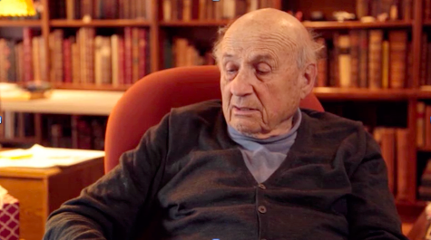
Physics Nobel Prize winner Walter Kohn
Notes:
Put in a possible new material
The computer solves the equations
Simulating what is happening
And out comes the answer
Materials design – should be able to find new materials faster.

Slide 22
Thank-you!
Slides : lucydot.github.io/slides
Notes:
Variou

